Slide 1

Resume Classification
Using Natural language processing

Slide 2
P333 – Group 5
Mentor: Priyanka Bindal
Group Members:
Jasmeet kaur
Khushi katre
Chetan salian
Jobin johnson
Mohammad abdul gouse

Slide 3
Resume Classification: Introduction
Resume classification, also known as resume parsing or resume screening, is a crucial aspect of modern recruitment processes. It involves the use of technology to analyze, categorize, and extract information from resumes to assist recruiters and employers in their hiring decisions.
Automated Screening: With the increasing volume of job applications, especially in large-scale recruitment processes, manually reviewing each resume can be time-consuming. Automated resume classification helps in quickly filtering and prioritizing resumes based on predefined criteria.
Efficient Talent Acquisition: By categorizing resumes into different job roles or industries, recruiters can efficiently identify candidates who match specific job requirements. This enhances the overall efficiency of the talent acquisition process.

Slide 4
Business Objective
Business objective of the document classification solution is to streamline and enhance the Human Resource Management (HRM) process by significantly reducing manual efforts. The solution aims to achieve a higher level of accuracy and automation, minimizing the need for extensive human intervention in the resume categorization and job role prediction.
Reduction in Manual Effort: The solution is designed to automate the classification of resumes, reducing the manual effort required for sorting and categorizing a large volume of job applications.
Time Savings: By automating the document classification process, the solution aims to save time for HR professionals, allowing them to focus on more strategic aspects of recruitment.
Higher Precision in Categorization: The document classification model is expected to provide accurate predictions of job roles or categories associated with each resume. This precision contributes to better decision-making in the hiring process.
Minimized Errors: The solution aims to minimize errors and misclassifications, ensuring that resumes are accurately assigned to the appropriate job categories.

Slide 5
Dataset (Resume Categories)
SQL Developer: Resumes falling under this category are likely from candidates with expertise in SQL (Structured Query Language) development. SQL Developers are skilled in designing, implementing, and maintaining database systems.
ReactJS Developer: Resumes categorized as ReactJS Developers indicate candidates specializing in front-end web development using the React.js library. These individuals are proficient in building interactive and user-friendly web applications.
PeopleSoft: Resumes in the PeopleSoft category suggest candidates with experience and skills related to PeopleSoft, an Oracle software product suite. This may involve expertise in areas such as ERP (Enterprise Resource Planning) and Human Capital Management.
Workday: Resumes classified under Workday indicate candidates familiar with Workday, a cloud-based software platform for financial management and human capital management. Professionals in this category may have skills in configuring and implementing Workday solutions.
Internship: The Internship category is designed for resumes of candidates seeking intern positions.

Slide 6
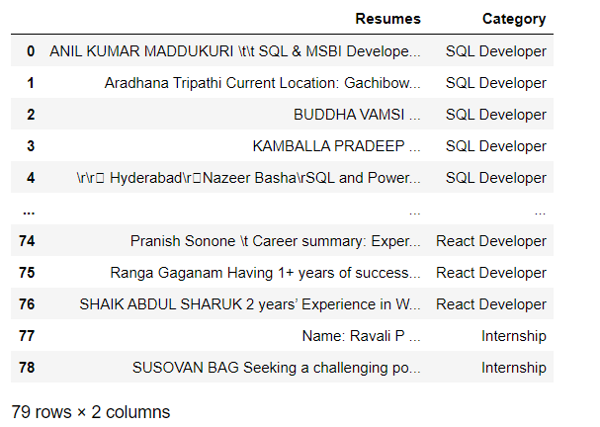
Importing the Resumes
First, we used read_doc_document, read_docx_document and read_pdf_document functions to extract text from documents in the .doc, .docx and .pdf formats respectively.
Next, we put extracted resumes into data frames, one for each category. This gave us five data frames separately for the five categories of resumes.
Finally, we concatenated all the five individual data frames into one data frame to create our raw data with 79 rows x 2 columns.

Slide 7
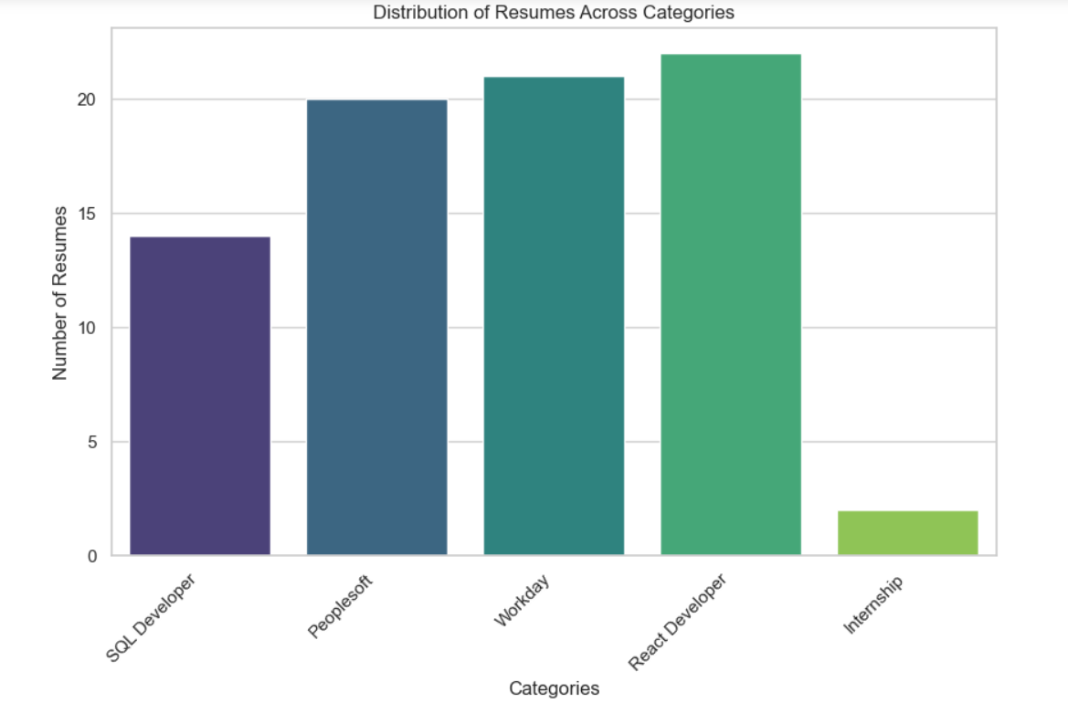
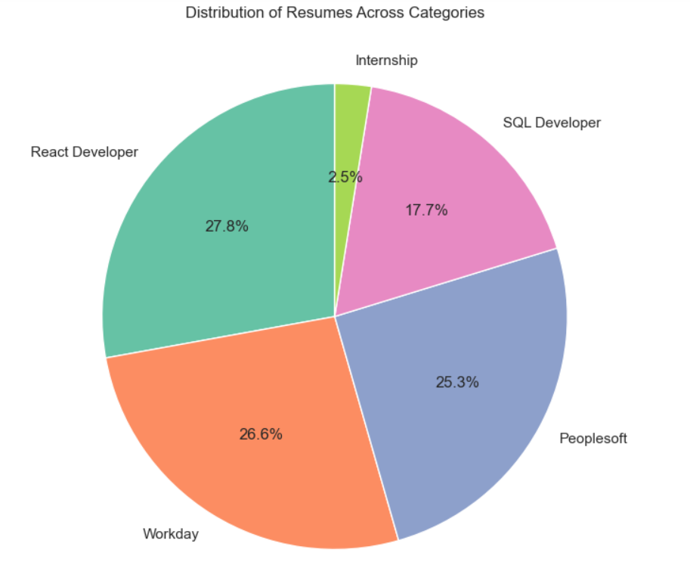
Data Visualization: Distribution of Resumes across categories

Slide 8
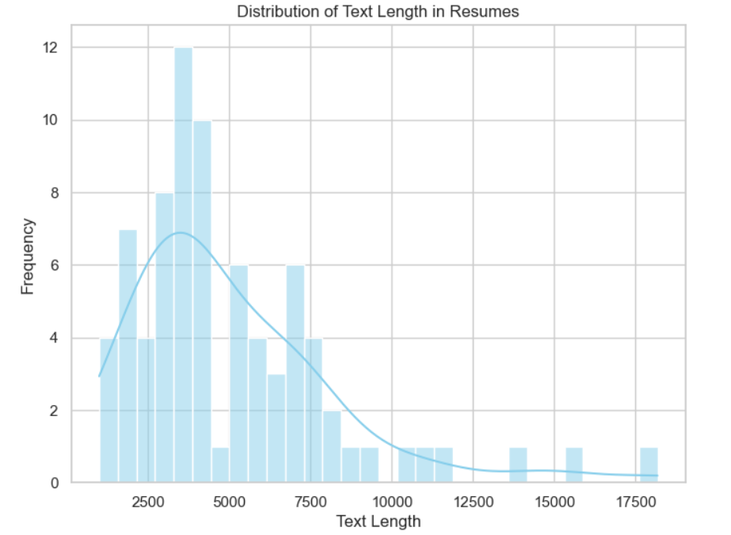
Data Visualization: Text length distribution
From the above text distribution graph we can interpret that many resumes have
text length of up to 2500 – 5000 words. 12 resumes have text length of approximately 4000.
We can also observe that some resumes have text length of as much as 15000-17500.

Slide 9
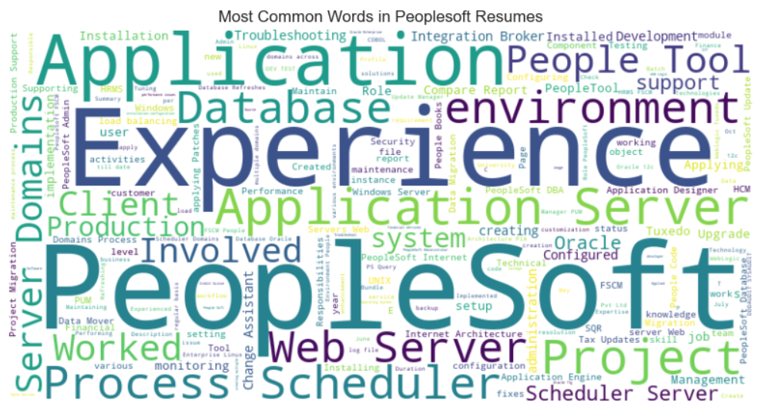
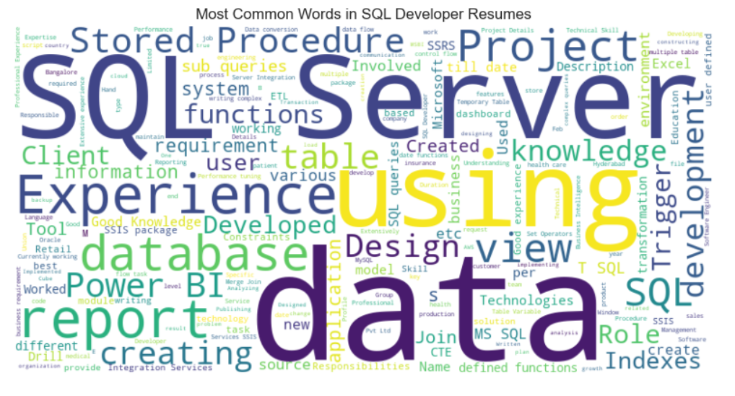
Data Visualization: WordCloud

Slide 10
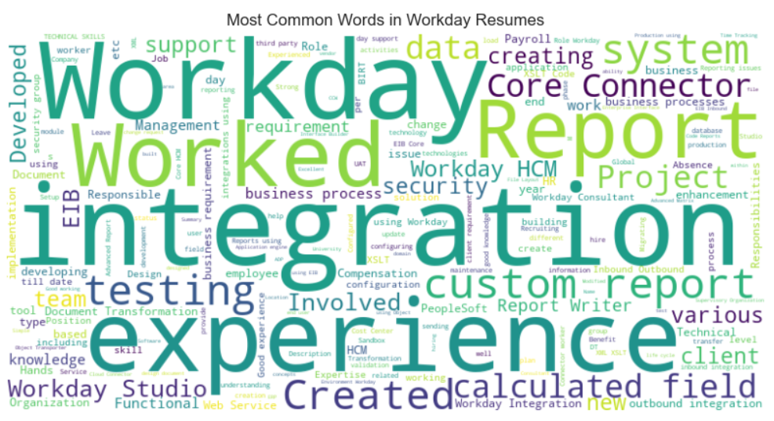
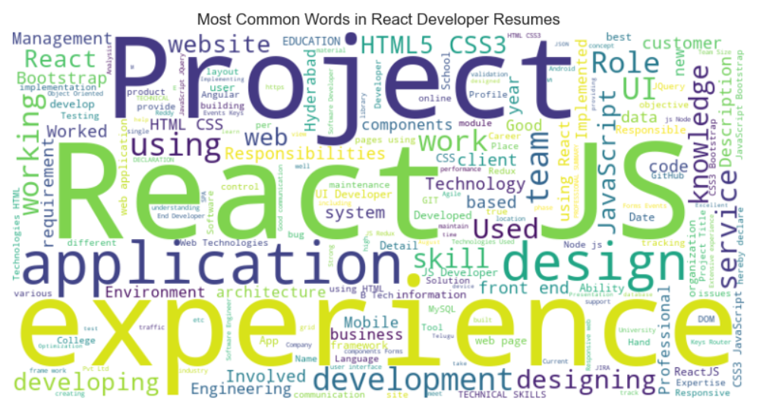
Data Visualization: WordCloud

Slide 11

Text Preprocessing: Data Cleaning
Removing URLs: URLs often don't contribute to the semantic meaning of the text and can be considered noise. Removing them helps in focusing on the relevant content.
Removing Mentions (@usernames): Usernames or mentions might not be relevant for resume classification and can be considered noise. Removing them helps in extracting the core textual content.
Removing Hashtags: Similar to mentions, hashtags might be specific to social media contexts. In resumes, they might not add substantial value to the classification task.
Removing Special Characters and Numbers: Special characters and numbers may not always contribute to the semantic meaning of the text. Removing them simplifies the text and can improve the efficiency of subsequent processing steps.
Handling Extra Whitespaces: Extra whitespaces, including leading or trailing spaces and multiple consecutive spaces, can introduce inconsistencies in the text. Normalizing whitespaces ensures uniformity.

Slide 12

Text Preprocessing: Stopwords Removal
Stopwords are commonly used words in a language that are generally filtered out before or after processing natural language data. These words, such as "and," "the," "is," etc., are frequently occurring but often don't carry significant meaning in the context of text analysis. Removing stopwords is a common step in text preprocessing and can have several benefits:
Reduced Dimensionality
Improved Efficiency
Enhanced Interpretability
Better Model Performance

Slide 13

Text Preprocessing: Removal of Punctuations
Punctuation removal is a common preprocessing step in natural language processing (NLP) that involves eliminating punctuation marks from text data. Punctuation marks include symbols such as periods, commas, question marks, exclamation points, and others. Here are the reasons why removal of punctuations is often performed:
Text consistency
Simplifies analysis
Prevents noise
Improves tokenization

Slide 14

Text Preprocessing: Lemmatization
Lemmatization is a natural language processing (NLP) technique that involves reducing words to their base or root form, known as the lemma. The goal of lemmatization is to transform words to a common base form, which helps in grouping together different inflected forms of a word.

Slide 15
Text Preprocessing: Named entity recognition
Named Entity Recognition (NER) is a subtask of natural language processing (NLP) that focuses on identifying and classifying entities within a body of text into predefined categories. Named entities are real-world objects that can be denoted by a proper name. These entities typically fall into categories such as:
Person: Individual people's names.
Organization: Company, agency, or institution names.
Location: Geographical places such as cities, countries, etc.
Date: Specific points in time.
Time: Expressions of time.
Money: Currency expressions.
Percentage: Percentage expressions.
Quantity: Numerical values that are counts or measures.

Slide 16
Text Preprocessing: Tokenization
Tokenization is a fundamental text processing task in natural language processing (NLP) that involves breaking down a sequence of text into individual units, called tokens. Tokens are the basic building blocks of natural language and can be words, subwords, or even characters, depending on the granularity chosen for the analysis. The process of tokenization is a crucial preprocessing step in various NLP applications, including machine learning models, text analysis, and information retrieval.
The primary goal of tokenization is to break down the text into words. This step is called word tokenization.

Slide 17
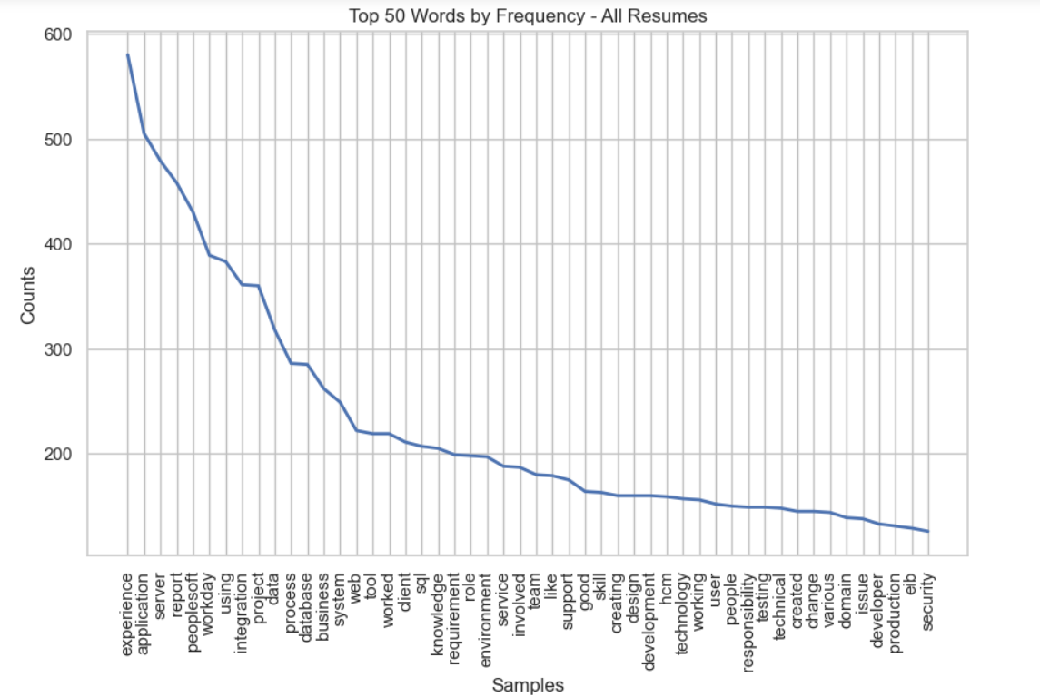
Text Processing: Word Frequency Analysis

Slide 18
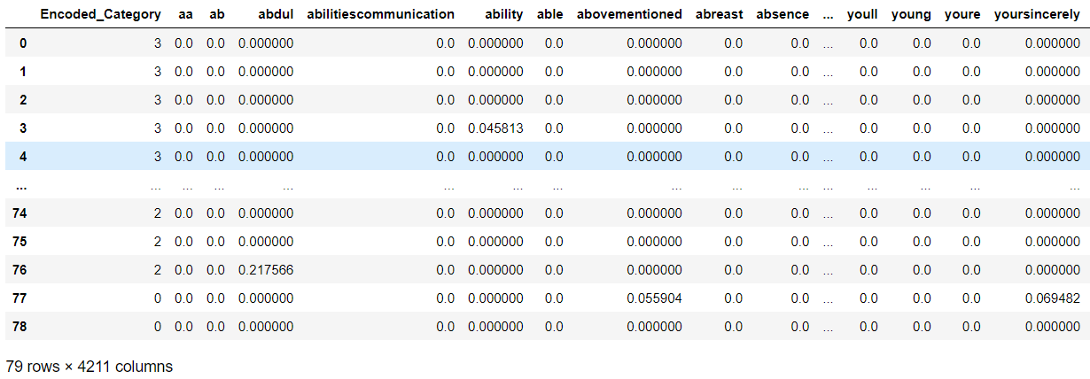
Vectorization
TF-IDF Vectorization (Term Frequency-Inverse Document Frequency): TF-IDF is a numerical statistic used in natural language processing and information retrieval to evaluate the importance of a word in a document relative to a collection of documents (corpus). It's a way to represent text data as numerical vectors, which are then used in machine learning algorithms. TF-IDF takes into account both the local and global importance of words in a document.
TF-IDF vectorization represents each document as a vector of TF-IDF scores for each term in the vocabulary. The resulting vectors can be used as input for machine learning models.

Slide 19
Machine Learning Models
For our model building, we have used the following classification models:
Logistic Regression: Linear model used for binary or multiclass classification by estimating probabilities via a logistic function.
Naive Bayes: Probabilistic classifier based on Bayes' theorem, assuming independence between features.
K-Nearest Neighbors (KNN): Instance-based learning where a data point is classified by the majority class of its k-nearest neighbors.
Decision Trees: Tree-like model where each internal node represents a decision based on features, leading to a final decision at the leaves.
Random Forest: Ensemble of decision trees, combining predictions to improve accuracy and reduce overfitting.
Support Vector Machines (SVM): Constructs a hyperplane to maximize the margin between classes, suitable for both linear and non-linear classification (using different kernels).
AdaBoost: Boosting algorithm that combines weak learners to create a strong learner by assigning weights to misclassified instances.
Gradient Boosting: Ensemble method building a series of weak learners sequentially, each correcting the errors of the previous one.

Slide 20
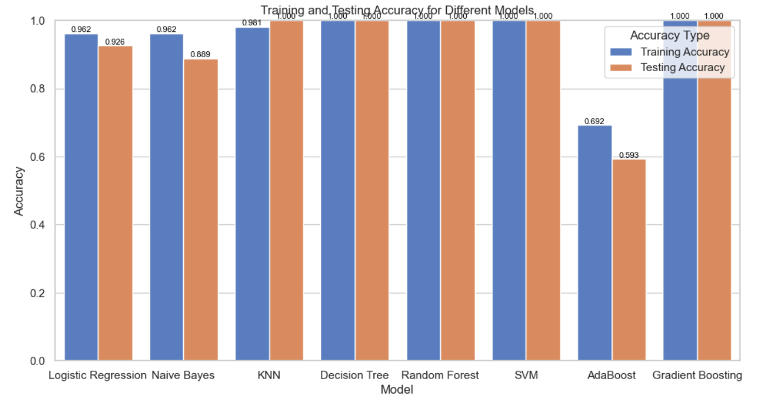
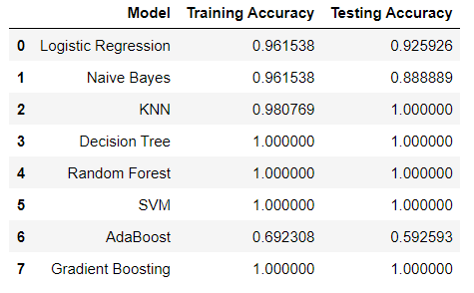
Model Evaluation
SVM and Decision Tree provided good results with kernel = ‘Linear’ and criterion = ‘gini’ respectively but showed diminished
results with rbf kernel and criterion = entropy while Random Forest model showed good results even with the base model without
hyperparameter tuning. Hence, we decided to choose Random Forest as our final model.

Slide 21
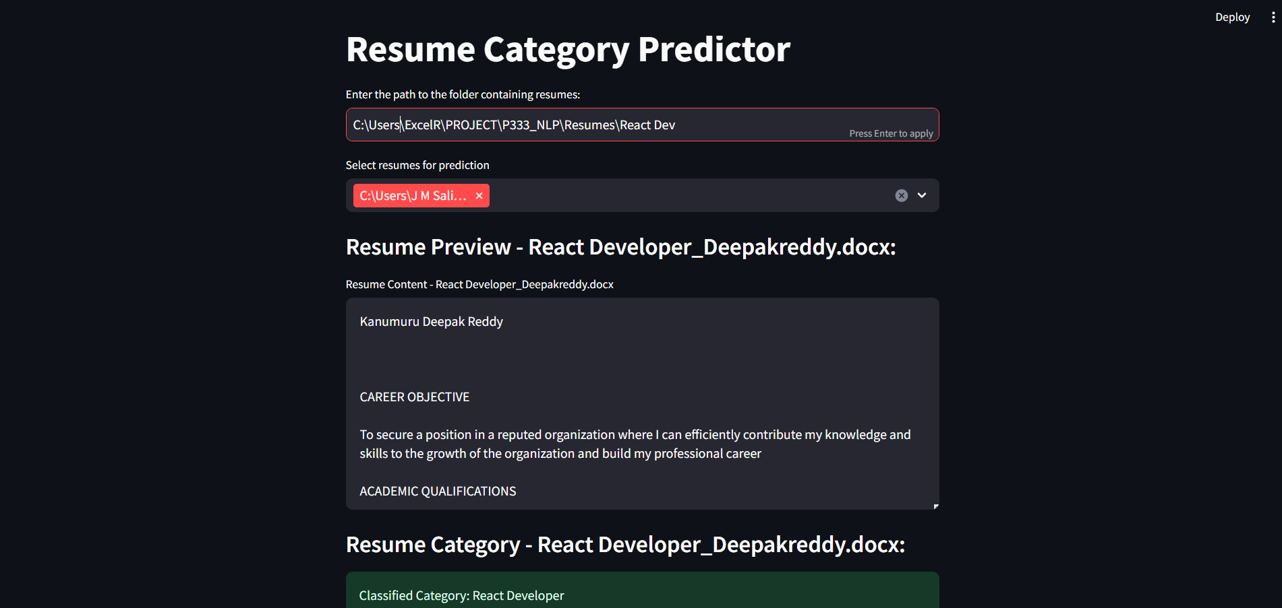
Deployment

Slide 22
Deployment
The app prompts the user to enter the path to the folder containing resumes in the section ‘Enter path to the folder containing resumes: ‘.
Once this is done, the user gets a list of all files (resumes) in the specified folder. Users can select multiple resumes from a dropdown list generated.
The dropdown displays the entire file path, but the user only needs to select the resumes they want to analyze.
For each selected resume, the app displays a sub-header with the resume's name and the preview of the content present in the resume.
The pre-trained machine learning model predicts the category of the resume.
Using this app, the user can also compare two different resumes of the same category.
Final output: The user gets a user-friendly interface where they can input a folder path, select resumes, and see the preview along with the predicted category for each selected resume.

Slide 23
Challenges Faced
We encountered difficulties with reading .doc format files (Microsoft Word 97-2003 document) mainly due to the differences in the file format and the absence of a straightforward text extraction method compared to .docx and .pdf files.
.doc files have a binary format and are in a different structure compared to the XML-based .docx files. The binary format makes it challenging to extract text directly.
Unlike the .docx format, which has a well-documented structure and libraries like python-docx for easy parsing, the older .doc format doesn't have a similar Python library with straightforward text extraction capabilities.The win32com.client library was employed to interface with the Word application and extract text from .doc files. This approach ensures compatibility with the binary format of older Word documents.
We also faced a challenge in choosing the right hyperparameters for the different models we worked upon and performed hyperparameter tuning using Grid Search CV .

Slide 24


